Slide 1



NQAS Certification of Public Health Facilities
Ms. Vinny Arora
Lead Consultant
Certification Unit
Quality & Patient Safety Division
NHSRC

Slide 2


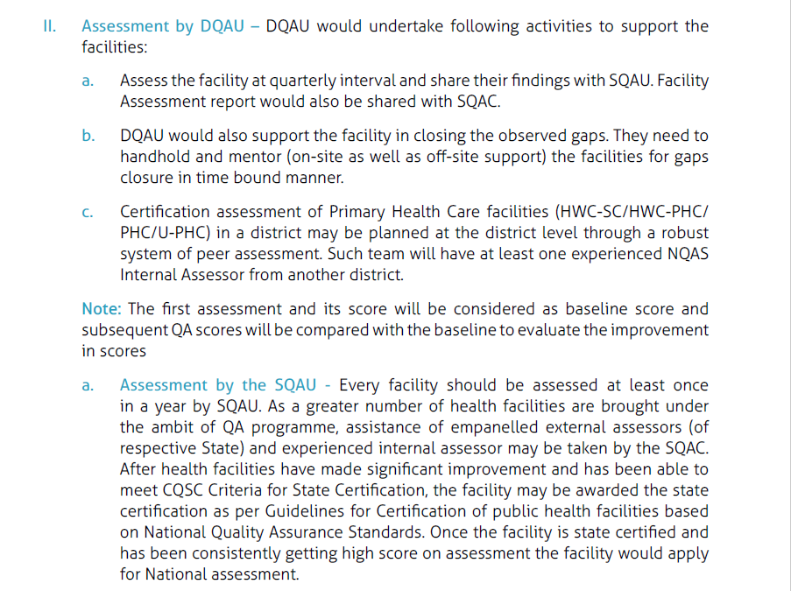
Level of Assessments
NQAS Certification of Public Health Facilities
National Level Assessment
State Level Assessment
राष्ट्रीय स्तर का मूल्यांकन
राज्य स्तर का मूल्यांकन

Slide 3




State Level Assessment
Assessment date scheduled
Planned through district level
Team of atleast 1 NQAS internal assessor of another district
Assessment conducted
After being State Certified, apply for the national-level assessment within six months
Result Declared
मूल्यांकन की तिथि निर्धारित की गई है
जिला स्तर के माध्यम से योजना बनाई गई है
कम से कम एक अन्य जिले के NQAS आंतरिक मूल्यांकनकर्ता की टीम
राज्य प्रमाणन प्राप्त होने के बाद, छह महीनों के भीतर राष्ट्रीय स्तर के मूल्यांकन के लिए आवेदन करें
मूल्यांकन किया गया
परिणाम घोषित

Slide 4

Mode of National Assessments
Mode of Assessments
Physical Assessments
(AAM-SHCs)
Virtual Assessments
(AAM-SHCs)
भौतिक मूल्यांकन
आभासी मूल्यांकन
Surprise Assessments
Physical Verification

Slide 5
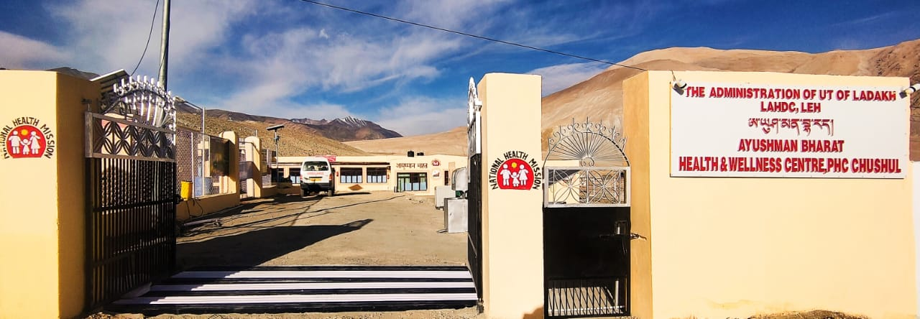






AYUSHMAN BHARAT-
HEALTH AND WELLNESS CENTRES

Slide 6








Certification process
Final Report
Preparation
Issuance of Certificate
Declaration of result by
NHSRC
Three (03) Year Validity
Assessor feedback requested from State & Facility
Assessment Guidelines & toolkit sent to assessors
Finalization of Assessment Team
Simplified Checklists & review of documents
Assessment Report review by
Certification Unit
Assessment Concluded
Submission of pre-requisite documents from the State
Document checked for Adequacy
Confirmation from the State/ Facility
PROCESS START
Application received from the State
Assessment dates allotted to the State
Assessment Scheduled
Review of documents

Slide 7





How to start the assessment process
01
Apply through SaQsham portal
सक्षम पोर्टल के माध्यम से आवेदन करें
"तिथियों के अंतिम रूप दिए जाने के बाद, मूल्यांकनकर्ता के विवरण सहित एक सूचना पत्र राज्य एवं संस्था (फैसिलिटी) को भेजा जाता है
02
Upon finalization of dates, an intimation letter along with the assessor’s details is sent to the State & Facility.
03
The assessment links are generated through Webex for virtual Assessments and shared a day before the assessment.
आभासी मूल्यांकन के लिए Webex के माध्यम से मूल्यांकन लिंक जनरेट किए जाते हैं और मूल्यांकन से एक दिन पूर्व साझा किए जाते हैं
04
Facility to check their internet connectivity a day prior and contact the assessors.
संस्था को मूल्यांकन से एक दिन पूर्व अपनी इंटरनेट कनेक्टिविटी की जांच करनी चाहिए और मूल्यांकनकर्ताओं से संपर्क करना चाहिए
05
Assessment is conducted and virtual monitoring is done from national level.
मूल्यांकन की राष्ट्रीय स्तर से निगरानी की जाती है

Slide 8
List of documents for NQAS Certification
Filled application form & Hospital data sheet.
Last district level assessment report verified by the state, not older than 6 months
Last month Quality Team’s minutes of meeting
Work instructions (as per service package)
Quality Policy
Last 3 months record of Patient Satisfaction Survey with CAPA Availability of a system for Biomedical Waste Management
Last 3 months record of Outcome Indicators*
State notified Essential Medicine List*
Last 3-months data from drug stock register for drugs availability as per state’s notified Essential Medicine List, signed by CHO or equivalent*
*Additional documents requested from the facility as compared to physical assessment

Slide 9
National Certification Criteria
Sl. No. | Criteria Name | Score Required (%) | Meets Criteria
1 | Aggregate score of the health facility | ≥ 70 | Criteria Met %
2 | Score of each Service Package of the health facility | ≥ 70 | Criteria Met
3 | Aggregated score in each Area of Concern | ≥ 60 % | Criteria Met
4 | Score of Standard of A1,D3,D4,D5,G2 | ≥ 60 % | Criteria Met Standard A1 - % Standard D3 - % Standard D4 - % Standard D5 - % Standard G2 - %
5 | Individual Standard wise score | ≥ 50 | Criteria Met
6 | Patient Satisfaction Score in the preceding quarter or more (Satisfied or Highly satisfied on Mera-Aspataal) | PSS ≥ 60 | Criteria Met (PSS Score - %)

Slide 10
Virtual Weightage Criteria
S. No. | Criteria | Weightage | Score Obtained
1 | State certification score of the facility | 25%
2 | Virtual assessment score of the facility | 40%
3 | PSS Score | 5%
4 | Service Availability | 10%
5 | Drugs Availability | 10%
6 | Diagnostic Availability | 5%
7 | Outcome Indicators | 5%
Total Score

Slide 11
Certification Outcome
Fully Certified
Overall score- 70% or above
Met all Criteria
Conditionally Certified
Overall score- 60% to 69%
Met five/four out of six mandatory criteria
Deferred
Overall score-less than 60%
Met three/two/one/no criteria
Facility can apply for Recertification after completion of validity through Virtual Mode.
A facility once deferred must apply through the physical mode of assessments.

Slide 12
Validity & Recertification
Validity
&
Re-certification
Fully Certified
Conditionally Certified
Deferred
Financial incentives
Apply for recertification after 33 months.
Apply afresh for recertification after 6 months.
Apply afresh for recertification once observed gaps closed.

Slide 13
Physical Verification of Virtually Certified facilities
Random Selection of certified AAM-SHC facilities of each State/UTs for physical verification assessment.
Scheduling of the assessment by team of 1 External Assessor & 1 Ayushman Assessor within 30 days .
Intimation letter or invitation email sent to the State and the deputed assessor at least 10 days before the scheduled assessment.
Name of the facility is communicated on the day of the scheduled assessment with the State and Assessors.
Physical verification assessment is conducted on scheduled date.
Deputed Assessors submit the report in prescribed format within 3 days of completion of assessment, result communicated to state

Slide 14
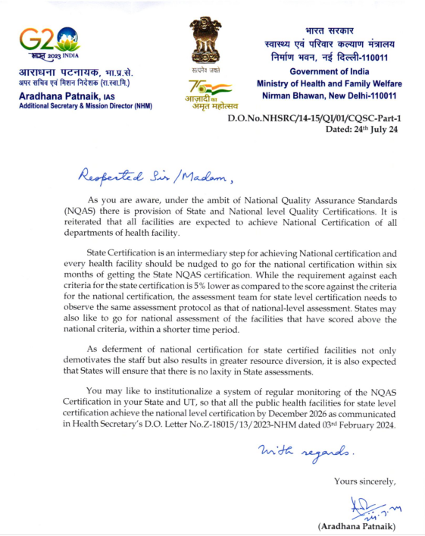
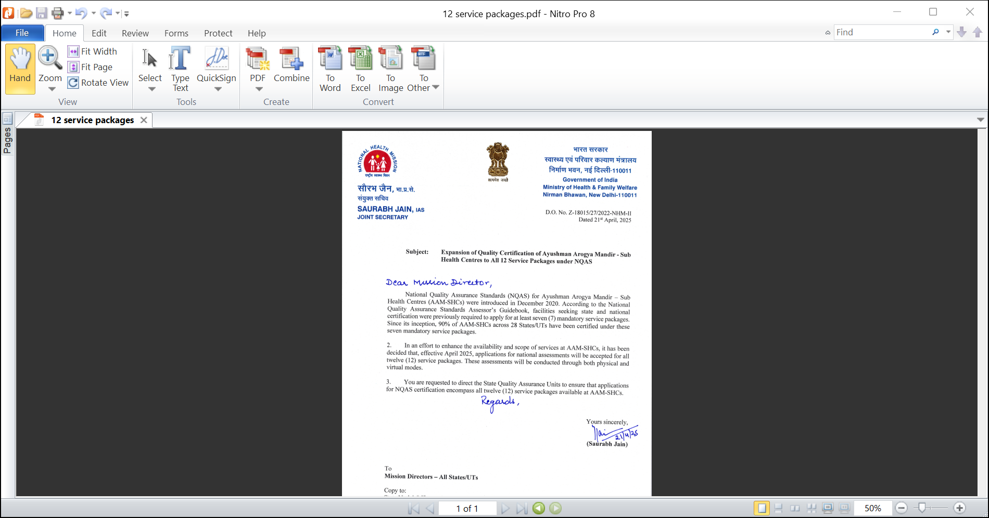
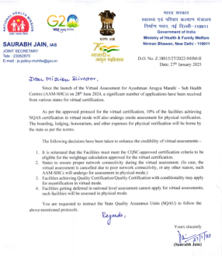
Letters from MoHFW
State Certification
12 Service Package
Physical Verification
https://qps.nhsrcindia.org/repository-standard/quality-QA-Directives

Slide 15

Thank You!

